Slide 1
NBL Merscope updates
David Smith
09/02/22

Slide 2
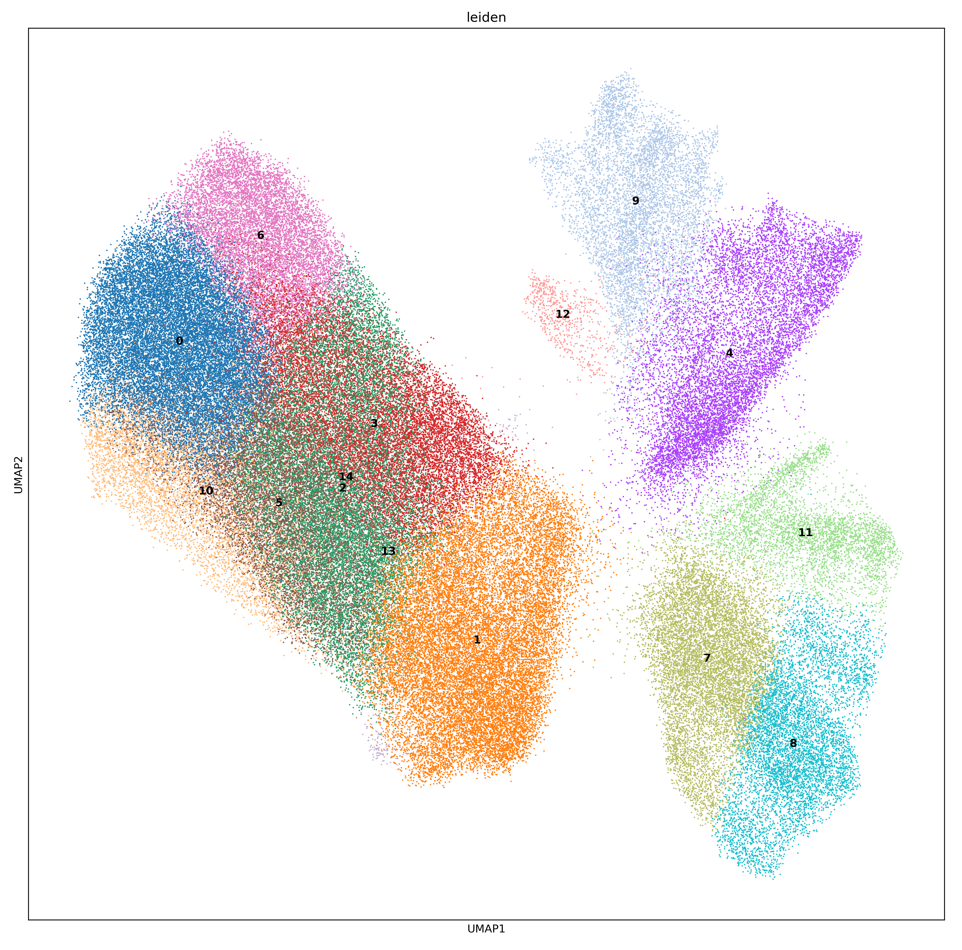
Refined Baysor segmentation
Ran a parameter sweep to find optimal segmentation results
Using previous cluster assignments (Yasin), made my best guess of cell phenotype based on top marker genes

Slide 3
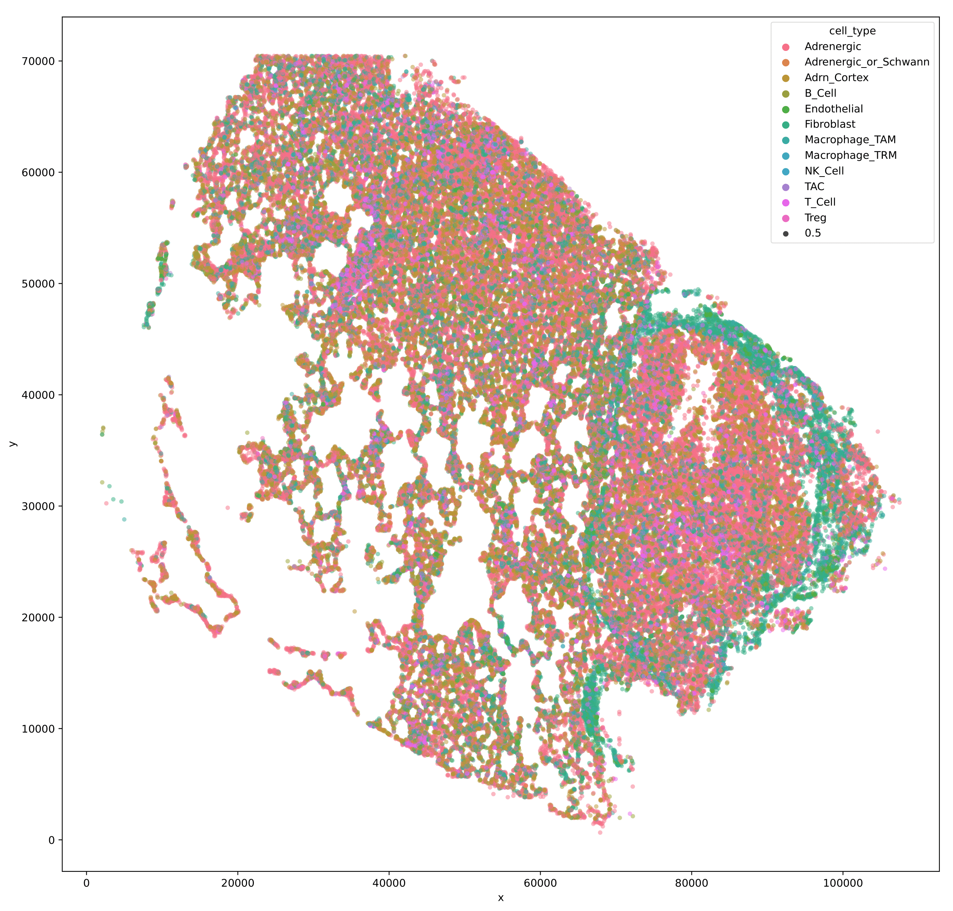
Cell Assignments

Slide 4
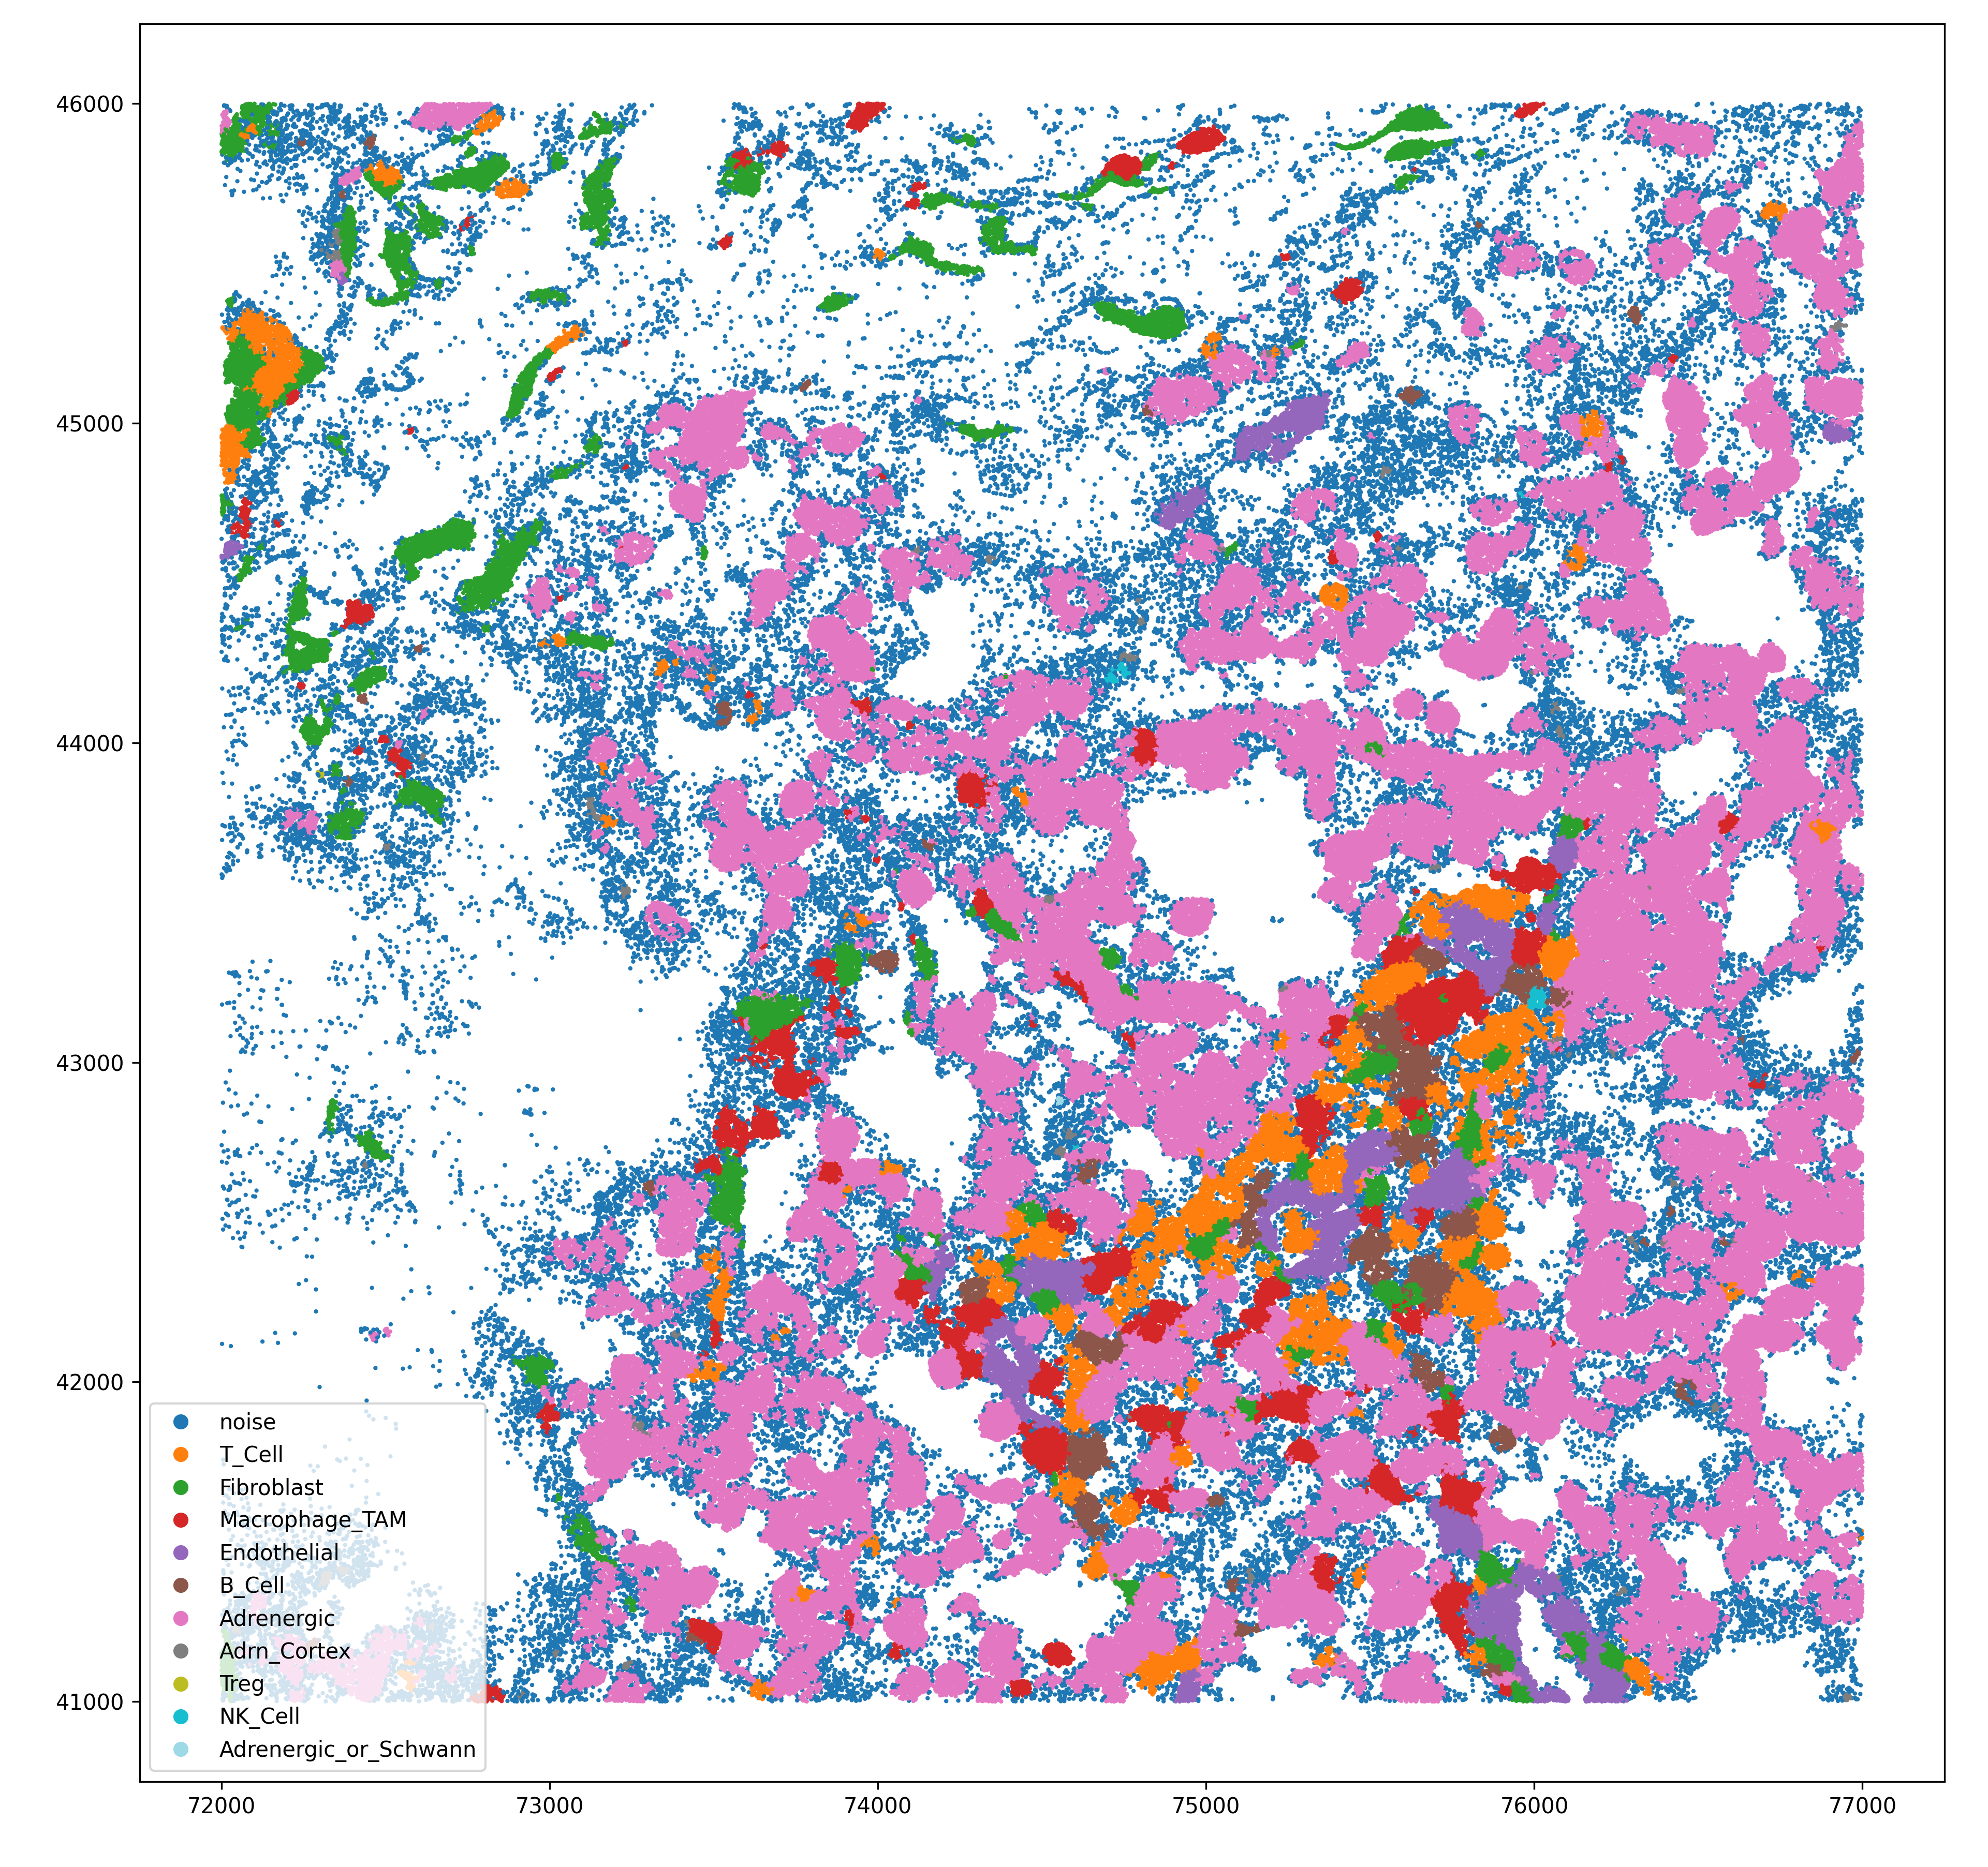
Cell Assignments (Zoom)

Slide 5
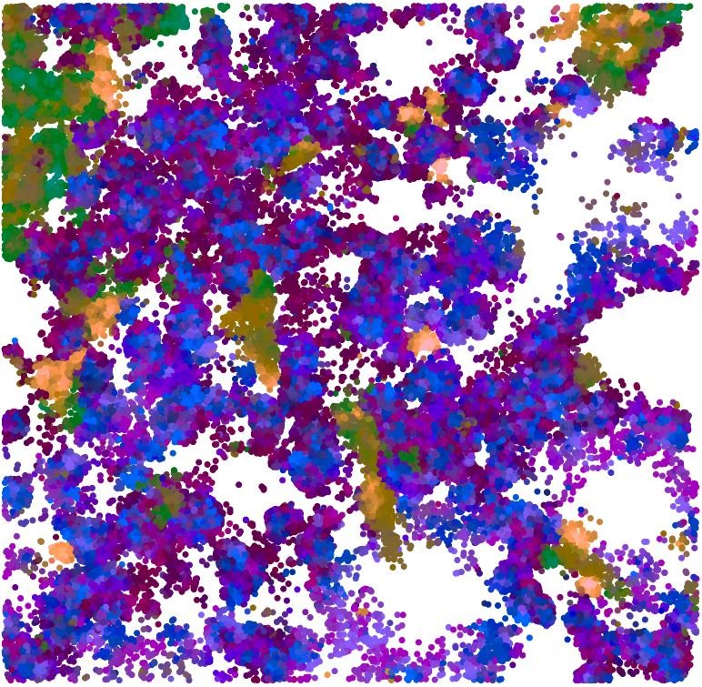
Cell Assignments (Zoom, different from previous)
The Baysor algorithm uses Neighbor Composition Vectors to define cell boundaries
On a molecule-to-molecule basis, the composition of the molecular neighborhood is used to determine the likelihood of nearby molecules belonging to the same cell
The composition vector can be represented in RGB space (shown here)
I noticed many small “cells” in the segmentation results and wonder if those molecules are actually subcellular phenomena.

Slide 6
Spatial Analysis
Used the SCIMAP package to perform:
Cell distance measurement
Cell interaction enrichment
Latent Dirichlet allocation (LDA) clustering; specified 6 Motifs
TAM clustering
Used Delauney triangulation to find the nearest neighbors of all TAM cells
Assigned TAM simplices into 2 clusters using kmeans

Slide 7
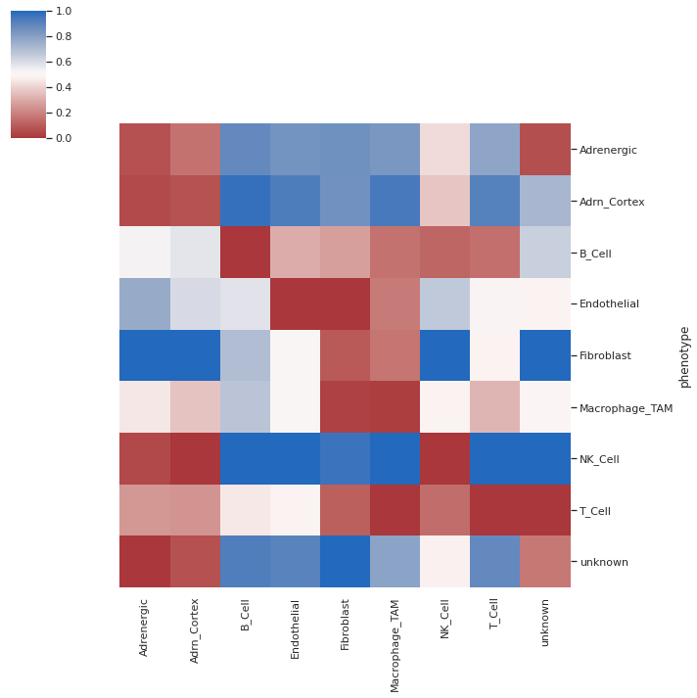
Distance Heatmap (Original Cell Types)

Slide 8
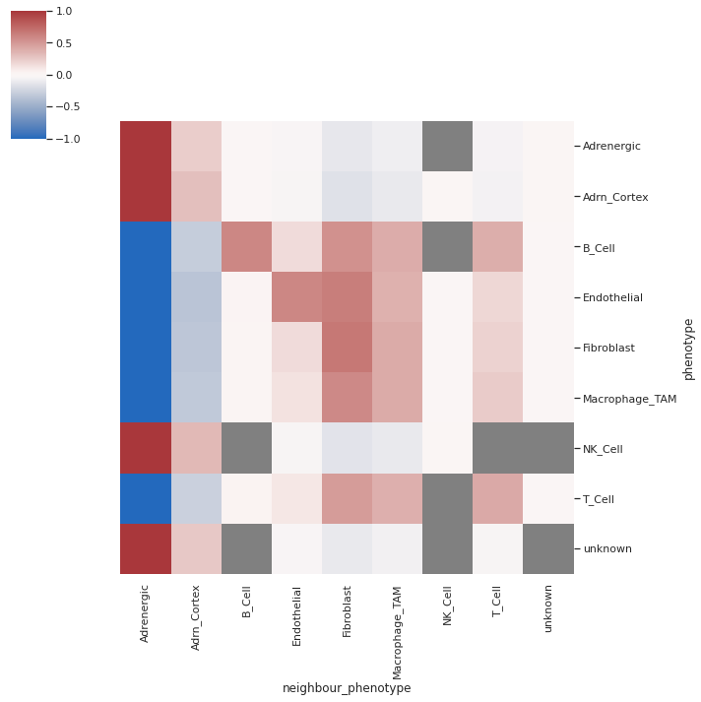
Cell-Cell Interaction Heatmap (Original Cell Types)
From SCIMAP:
“The spatial_interaction function enables the unbiased and systematic study of all cell–cell interactions present in a tissue or all tissues of a sample cohort by using a permutation test to compare the number of interactions between all cell types in a given image to that of a matched control containing randomized cell phenotypes. This approach determines the significance of cell–cell interactions and reveals enrichments or depletions in cell–cell interactions that are indicative of cellular organization. “

Slide 9
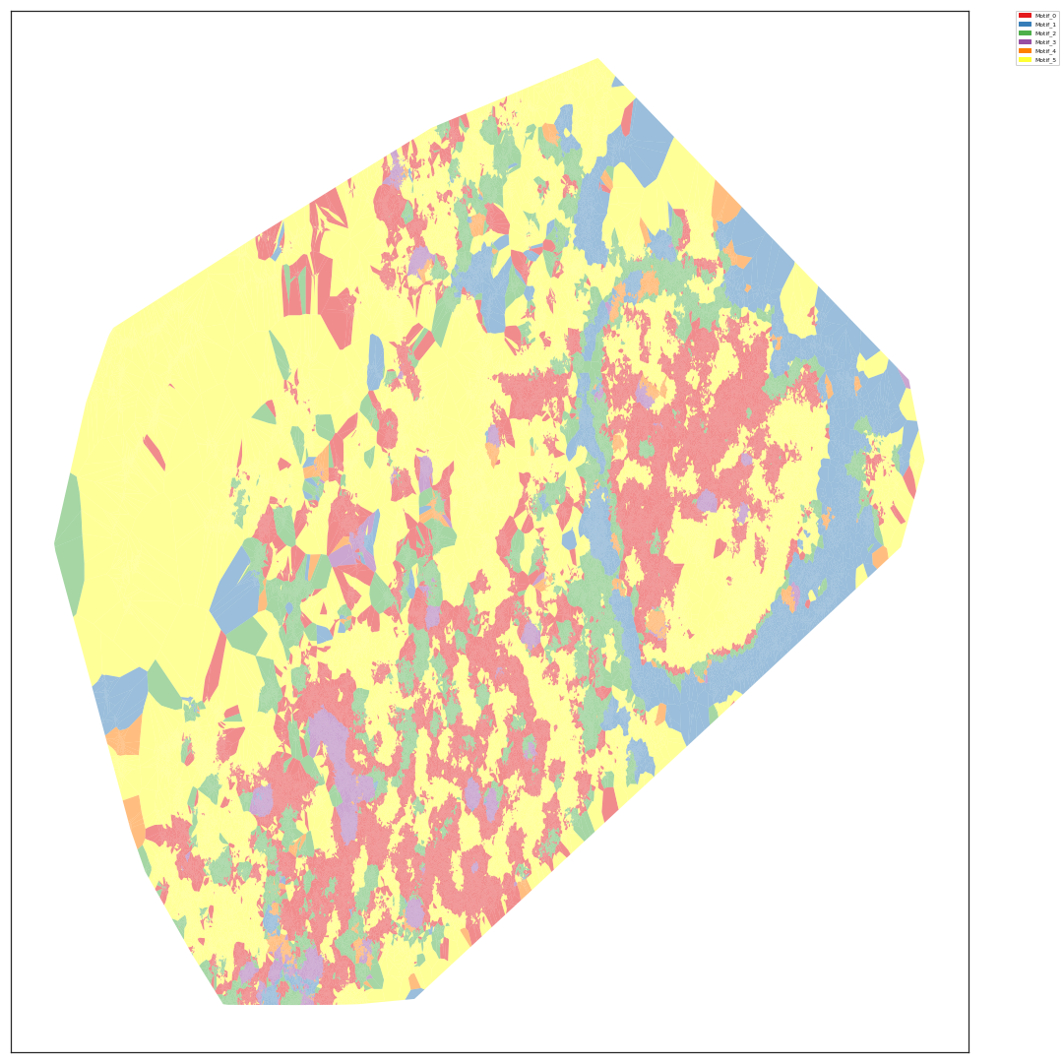
LDA motif clustering (Original Cell Types)

Slide 10
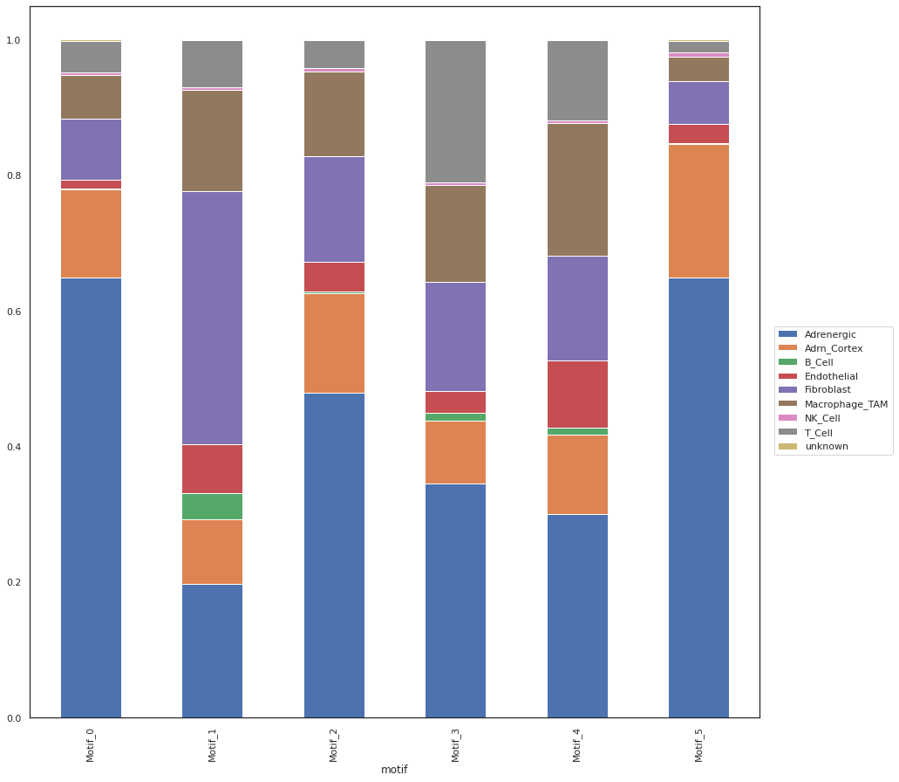
LDA motif composition (Original Cell Types)

Slide 11
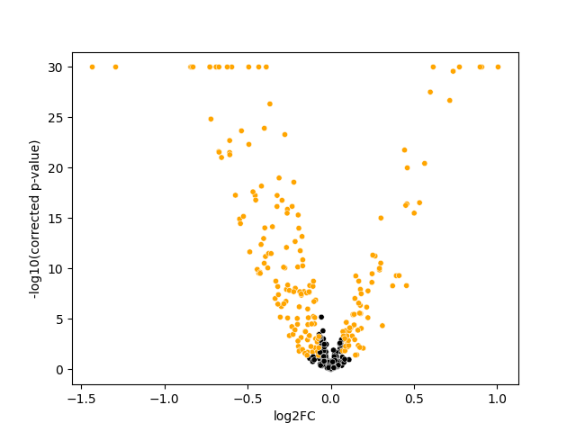
TAM Cluster Differential Expression
Welch’s T-test between TAM cluster 1 and TAM cluster 2
“Macrophage_TAM_1” was considered the reference level

Slide 12
What are the differentially genes?

Slide 13
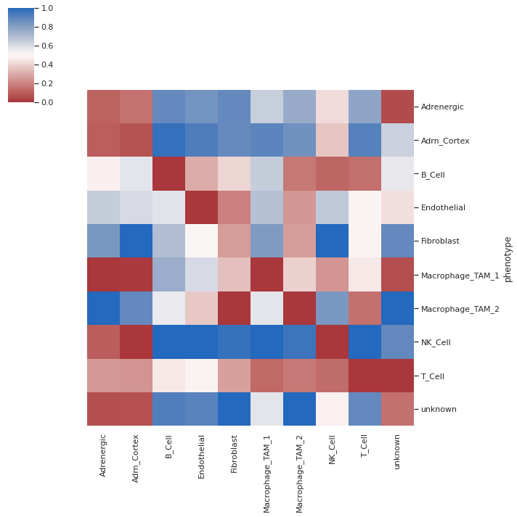
Distance Heatmap (With TAM clusters)

Slide 14
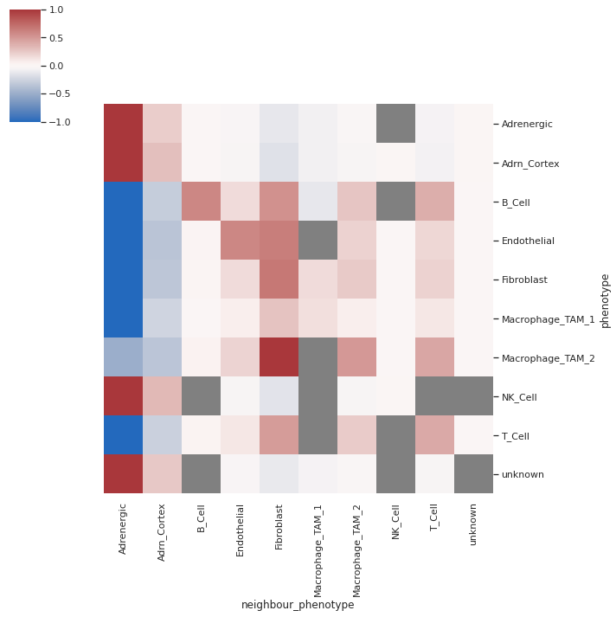
Cell-Cell Interaction Heatmap (With TAM clusters)

Slide 15
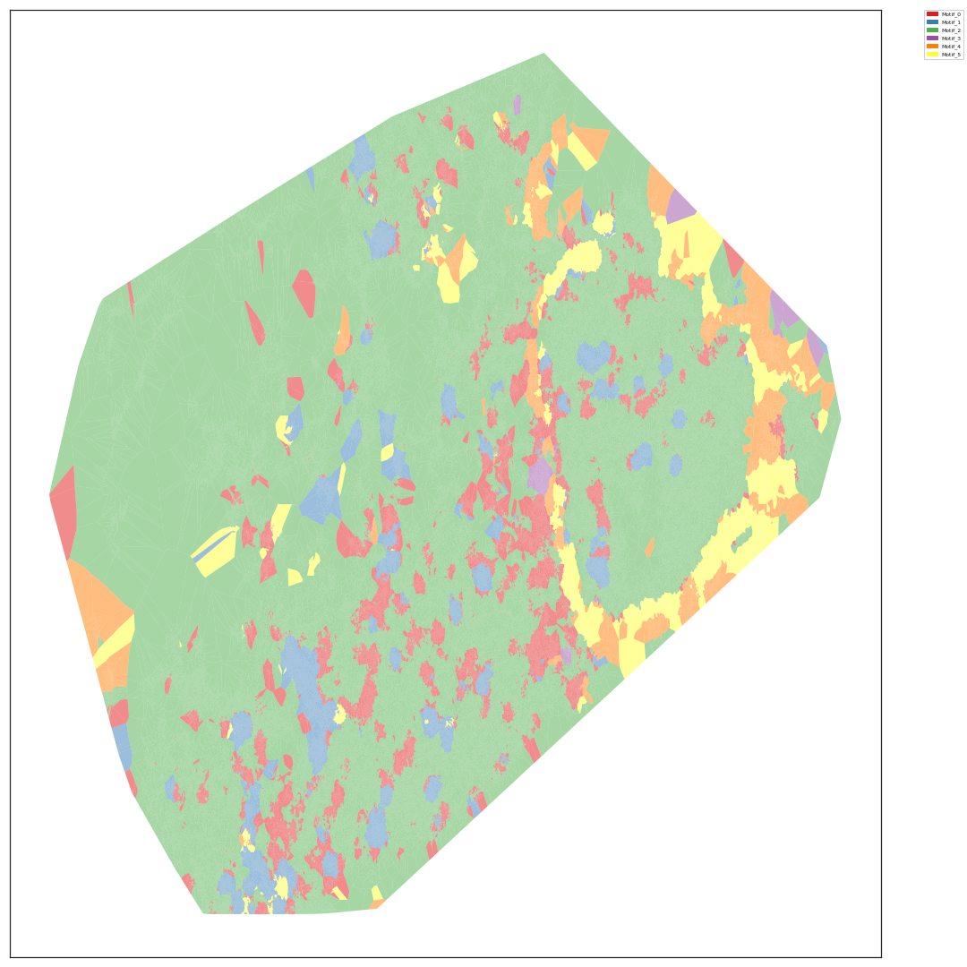
LDA motif clustering (with TAM clusters)

Slide 16
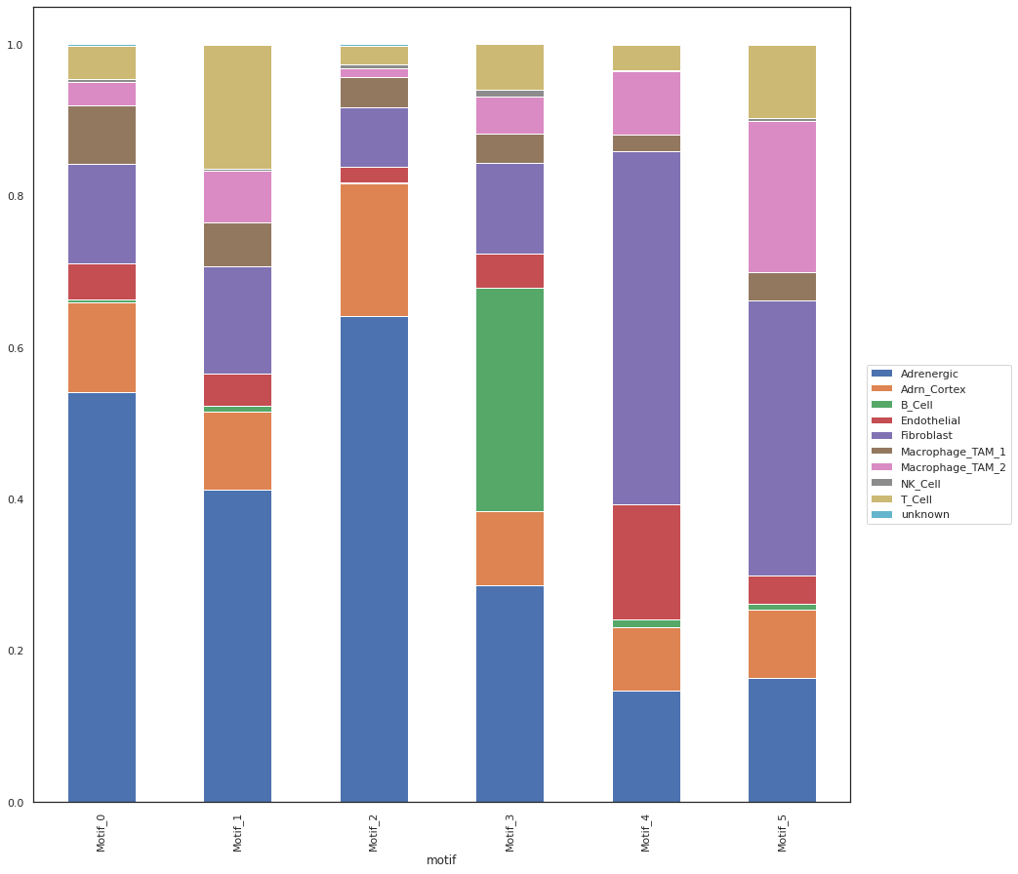
LDA motif composition (with TAM clusters)

